Slide 1





Regular Expressions (RegEx)
Advanced Text Manipulation
SoftUni Team
Technical Trainers
Software University
http://softuni.bg

Slide 2

Table of Contents
Regular Expressions
What are Regular Expressions?
Characters
Operators
Constructs
Regular Expressions in Python

Slide 3
Questions
sli.do #PythonFundamentals

Slide 4
Regular Expressions
Groups, Quantifiers, Anchors

Slide 5
Regular Expressions
Describe a search pattern
Can be used to extract data from text
[A-Z][a-z]+ [A-Z][a-z]+ - \w+@\w+\.\w+
matches
Ivan Ivanov – ivan@gmail.com
Petar Iotov – petar@abv.bg
Contact: Alex Georgiev – alex@mail.com...

Slide 6
Character Classes
[nvj] matches any character that is either n, v or j
[^abc] – matches any character that is not a, b or c
[0-9] - Character range: Мatches any digit frm 0 to 9
node.js v0.12.2
Abraham Lincoln
In 1519 Leonardo da Vinci died at the age of 67.

Slide 7
Character Classes (2)
\w – Matches any word character (a-z, A-Z, 0-9, _)
\W – Matches any non-word character (the opposite of \w)
\s – Matches any white-space character
\S – Matches any non-white-space character (opposite of \s)
\d – Matches any decimal digit
\D – Matches any non-decimal digit (opposite of \d)
aBcd 09_ &*^ Ю-Я
aBcd 09_ &*^ Ю-Я
Notes:
\w – Matches any word character (a-z, A-Z, 0-9, _)
\W – Matches any non-word character (the opposite of \w)
\s – Matches any white-space character
\S – Matches any non-white-space character (opposite of \s)
\d – Matches any decimal digit
\D – Matches any non-digit character (opposite of \d)

Slide 8
Quantifiers
* - Matches the previous element zero or more times
+ - Matches the previous element one or more times
? - Matches the previous element zero or one time
+359885976002
+
\+\d*
=>
+359885976002
+
\+\d+
=>
\+\d?
=>
+359885976002
+

Slide 9
Character Escapes
Sometimes you will need to look for special characters like new lines or tabulations
This is a “tab”
Then we have a new line
Name: Peter
Phone: +359882042353
We can use character escapes in our RegEx like that:
Name:\t\w+\nPhone:\s*\+\d+

Slide 10

Anchors
^ - The match must start at the beginning of the string or line
$ - The match must occur at the end of the string
Example – username validation pattern:
Note: Test one by one, $ asserts string end
^\w{6,12}$
jeff_butt
short
johnny
too_long_username
!lleg@l_ch@rs

Slide 11

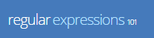
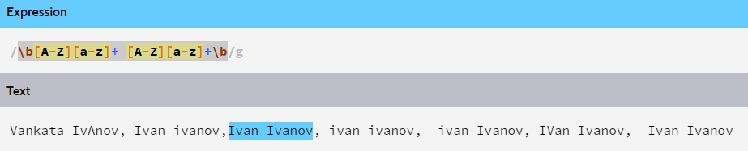
Problem: Match full name
You are given a sequence of words
Find those who are full names
You can use RegXr or Regex101

Slide 12
Grouping Constructs
(subexpression) - captures the matched subexpression and assigns it a number
(?:subexpression) – Defines a non-capturing group
\d{2}-(\w{3})-\d{4}
=>
22-Jan-2015
^(?:Hi|hello),\s*(\w+)$
=>
Hi, Peter

Slide 13
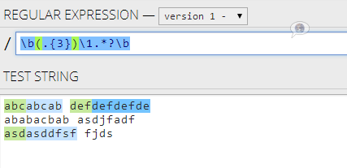
Backreference Constructs

Slide 14
Backreference Constructs
\number – matches the value of a numbered subexpression
\k<name> – matches the value of a named expression
22-12-2015
05/08/2016
\d{2}(-|\/)\d{2}\1\d{4}
=>
22-12-2015
05/08/2016
\d{2}(?<del>-|\/)\d{2}\k<del>\d{4}
=>

Slide 15

Playing with RegEx
Exercises in class

Slide 16
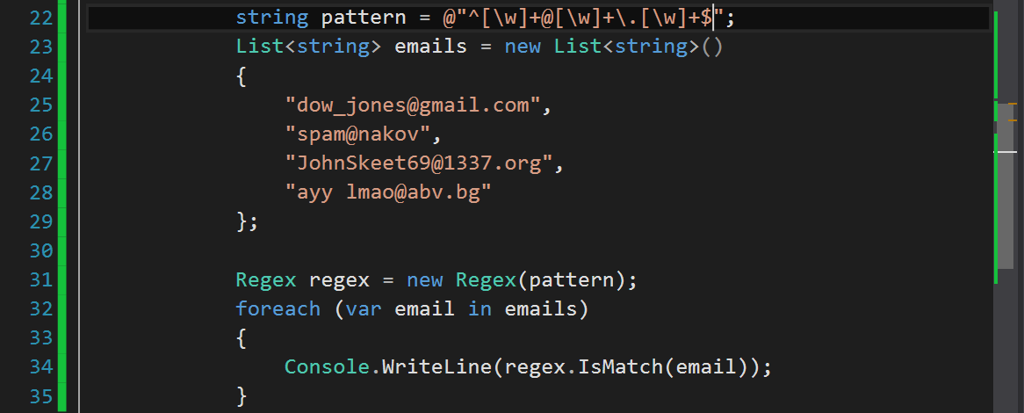
Regular Expressions
Using Built-In Regex Classes

Slide 17
Regex
Python supports a built-in regular expression library - re
import re
pattern = "A\w+"
regex = re.compile(pattern)
regex = r"A\w+"

Slide 18
Validating String By Pattern
determines whether the text matches the pattern:
text = "Today is 2015-05-11"
pattern = r"\d{4}-\d{2}-\d{2}"
regex = re.compile(pattern)
containsValidDate = (re.findall(text) != [])
print(containsValidDate) # True

Slide 19
Checking for Matches
Re.findall(pattern, text) – returns a collection of matching strings that correspond to the pattern
text = "Nakov: 123, Branson: 456"
regex = r"([A-Z][a-z]+): (\d+)"
matches = re.findall(regex, text)
print("Found {} matches".format(len(matches)))
for match in matches:
print("Name:", match[0])
# Found 2 matches
# Name: Nakov
# Name: Branson

Slide 20
Replacing With Regex
re.replace(pattern, replacement, text) – replaces all strings that match the pattern with the provided replacement
text = "Nakov: 123, Branson: 456"
pattern = r"\d{3}"
replacement = "999"
result = re.sub(pattern, replacement, text)
print(result)
# Nakov: 999, Branson: 999

Slide 21
Problem: Replace <a> tag
You are given a html text.
Replace all <a> tags in it with [URL].
<ul> <li> <a href="http://softuni.bg">SoftUni</a>
</li> </ul>
<ul> <li> [URL href="http://softuni.bg"]SoftUni[/URL]
</li></ul>
Check your solution here: https://judge.softuni.bg/Contests/Practice/Index/320#7

Slide 22
Solution: Replace <a> tag
text = input()
while text != "end":
pattern = r"<a.*?href.*?=(.*)>(.*?)<\/a>"
replace = "[URL href=$1]$2[/URL]"
replaced = re.replace(pattern, replace, text)
print(replaced)
text = input()
Notes:
You can try also: @"<a.*href=((?:.|\n)*?(?=>))>((?:.|\n)*?(?=<))<\/a>"

Slide 23
Splitting With Regex
pattern.split(text) – splits the text by the pattern
Returns list of string
text = "1 2 3 4"
pattern = r"\s+"
results = pattern.split(text)
print(", ".Join(results)) # 1, 2, 3, 4

Slide 24
Built-in RegEx
Exercises in class

Slide 25

Summary
Regular expressions describe patterns:
for searching through text
Define special characters
Define special operators
Define special constructs
for building complex patterns

Slide 26








Regular Expressions (RegEx)
https://softuni.bg/courses/programming-fundamentals

Slide 27

License
This course (slides, examples, demos, videos, homework, etc.) is licensed under the "Creative Commons Attribution-NonCommercial-ShareAlike 4.0 International" license
Attribution: this work may contain portions from
"Fundamentals of Computer Programming with C#" book by Svetlin Nakov & Co. under CC-BY-SA license
"C# Part I" course by Telerik Academy under CC-BY-NC-SA license
"C# Part II" course by Telerik Academy under CC-BY-NC-SA license

Slide 28




Trainings @ Software University
Software University Foundation – softuni.org
Software University – High-Quality Education, Profession and Job for Software Developers
softuni.bg
Software University @ Facebook
facebook.com/SoftwareUniversity
Software University Forums – forum.softuni.bg

